Slide 1
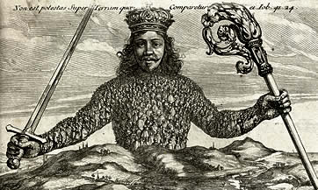
Hobbes III: The Contract and the Leviathan
Politics 2A
Dr Carl Knight, Lecturer in Political Theory

Slide 2
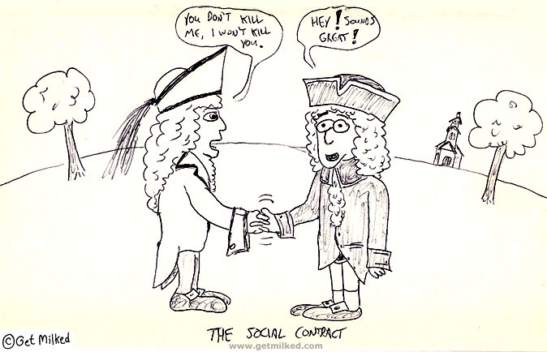
RECAP
‘Finall cause, end, or designe’ is self-preservation (right of nature)
This means ‘getting themselves out from that miserable condition of warre’ (Leviathan, ch. 17)
2nd law of nature – give up right of nature where others agree to give up their own right of nature

Slide 3

NOT WORTH THE PAPER…
‘covenants, without the sword, are but words, and of no strength to secure a man at all’
But why are contracts broken in state of nature?
Irrational human nature? ‘the Lawes of Nature … of themselves, without the terrour of some power, to cause them to be observed, are contrary to our naturall passions, that carry us to partiality, pride, revenge, and the like’.
Or rationality itself? Prisoner’s Dilemma (Gauthier)

Slide 4
 | Prisoner B silent | Prisoner B betrays
Prisoner A silent | 1 year each | Prisoner A, 3 years Prisoner B, 0 years
Prisoner A betrays | Prisoner A, 0 years Prisoner B, 3 years | 2 years each
PRISONER’S DILEMMA
Individually rational behaviour=suboptimal outcome
But if Hobbes meant this, why focus on ‘passions’?
Does iterated prisoner’s dilemma solve problem?

Slide 5

THE SOCIAL CONTRACT
Hobbes way out of SoN: ‘tye them by feare of punishment to the performance of their covenants’
‘conferre all their power and strength upon one Man, or upon one Assembley of men, that may reduce all their Wills, by plurality of voices, unto one Will’
‘I Authorise and give up my Right of Governing my selfe, to this Man, or to this Assembly of men, on this condition, that thou give up thy Right to him, and Authorise all his Actions in like manner’.

Slide 6
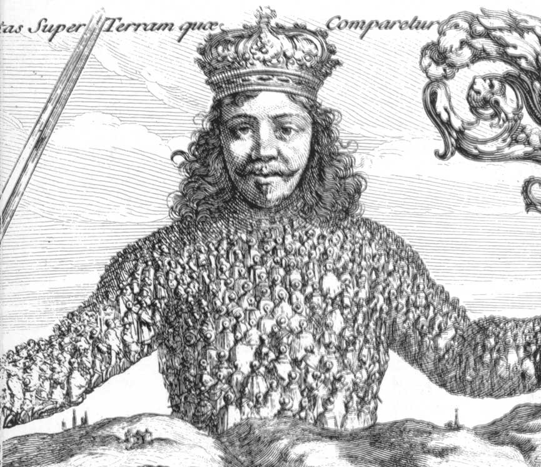
THE LEVIATHAN
‘This done, the Multitude so united in one Person, is called a COMMON-WEALTH, in latine CIVITAS. This is the Generation of that great LEVIATHAN, or rather … of that Mortall God, to which wee owe under the Immortall God, our peace and defence. For by this Authoritie, given him by every particular man in the Common-Wealth, he hath the use of so much Power and Strength conferred on him, that by terror thereof, he is inabled to forme the wills of them all… And he that carryeth this Person, is called SOVERAIGNE’

Slide 7
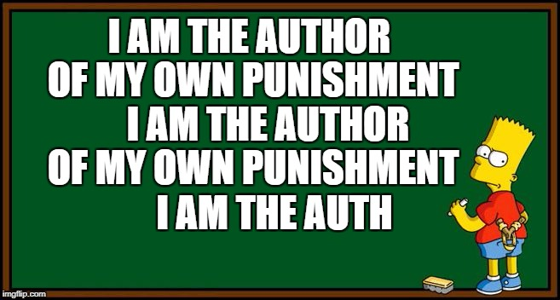
AUTHORSHIP
Each individual is the author of the covenant, so each is bound by it: ‘everyone to owne, and acknowledge himselfe to be Author of whatsoever he that so beareth their person shall act’
To oppose the Sovereign is to oppose yourself, a contradiction (violation of covenant)
You are even author of your own punishment

Slide 8

POWERS
To say Soveraign is unjust is to say we injure ourselves - impossible.
Sovereign cannot forfeit Sovereignty - not party to covenant therefore cannot break it.
Soveraign is to create peace and therefore may do ‘whatsoever he shall think necessary to be done’.
Censorship, taxes, spending, war, law, ministers
‘a Kingdom divided in it selfe cannot stand’
Staying is tacit consent to sovereignty

Slide 9

LIMITATIONS
Soveraign ‘may commit iniquity’
May believe what you wish privately
Fundamental right to self-preservation retained:
1. Criminal can and must resist
2. soldier could flee if taken into battle with no prospect of victory
3. starvation (in extremis)
4. If Soveraign fails to defend, you’re no longer obliged

Slide 10

ACTIVITY
Would people in the state of nature agree to be ruled by Hobbes’ ‘Soveraign’?
You may wish to discuss Hobbes’ arguments about:
The ‘nasty, brutish, and short’ state of nature
Enforcement of the social contract
The powers of the sovereign
The individual’s retained right to self-preservation

Slide 11
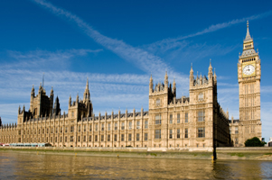
FORMS OF GOVERNMENT
Three possible rulers:
1. one (monarchy)
2. many (aristocracy)
3. all (democracy)
Other supposed forms (tyranny, oligarchy, anarchy) ‘are not the names of other Formes of Government, but of the same Formes misliked’ (Leviathan, ch 19)

Slide 12

ARGUMENT FOR MONARCHY
Advantages for monarchy: (1) own interest is common interest
(2) can take advice of anyone, whenever
(3) consistent
(4) cannot be envious of or disagree with self
(5) can reject mistaken majority
Disadvantages: (1) Favourites may be advanced in monarchy, but flattery bigger problem in democracy; (2) accession of a child, but this is fixed by regency

Slide 13
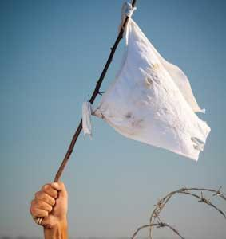
COMMONWEALTH BY ACQUISITION
Main argument applies to ‘common-wealth by institution’, where ‘men agree among themselves’
There is also commonwealth by acquisition, ‘where the soveraign power is acquired by force’ (ch 20)
‘Rights, and consequences of Soveraignty, are the same in both’
Surrender in war is tacit admission of political submission – ruler authorized to demand loyalty
Why submit? Avoid state of war & wrath of sovereign
Contract agreed through fear still stands

Slide 14
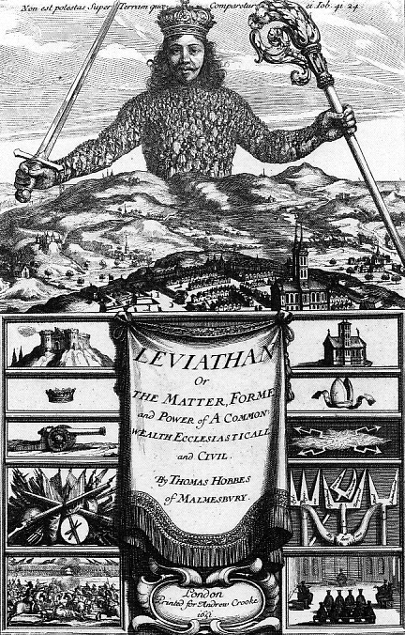
SUMMARY
State of nature is ‘nasty, brutish, and short’
Laws of nature lead individuals to seek peace through contract
Sovereign is required to enforce contract
Sovereign has near total power
Monarchy=best government
Sovereignty may be forced

Slide 15
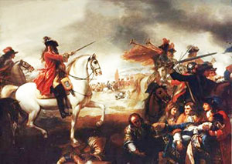
Next Lecture: The Glorious Revolution (Craig Smith)

